Slide 1
EDC Background 2016
EDC Journey
EDC Operating Model
Engagement models
Security
Suppliers

Slide 2

Extended Delivery Centre (EDC) - The Journey
The EDC is a concept separate from any specific supplier and is an extension of Nordea’s IT Capability
1500+ FTE’s
40 FTE’s
2006
Capgemini
(IT Finance)
2009
ITAS* program established.
Pilots within Private Banking and Capital Markets
2010
Preferred EDC partners selected:
- Accenture
- Larsen and Toubro
2011
Other IT areas embarks on
off-shoring
EDC Concept Owner model is established
2012
ITAS closed,
Tieto becomes preferred EDC partner and the EDC unit is established
2013/2014
Focus on Operational Strategy
2015
Capgemini – official EDC supplier
Compliance focus
2016
Alignment of EDC suppliers
*ITAS = IT Application Services
2 •

Slide 3
ITAS Programme – The Journey
The ITAS Programme (IT Application Sourcing) was established in 2009
The goal was
to establish a common way of working with Extended Delivery Centres
to choose and make agreements with EDC suppliers
The 5 Key Drivers for Offshoring
Scalability: Reducing dependencies on key (scarce) resources
Flexibility: Increasing resource flexibility, enabling Nordea to respond more quickly to changing market conditions
Access to talent: Continues access to scarce talent pool / specialist fulfilling challenging business demands
Cost: Placing Nordea at a lower cost curve, ensuring that we are not having a competitive disadvantage
Quality: Improving delivery quality by improving standardization and performance measurements

Slide 4
EDC Operating Model
EDC Executive Responsible
Head of EDC (Group IT, IT Sourcing)
EDC Executive Board
EDC Services and Processes
Engagement Review
Engagement Review
Engagement Review
Engagement Review
Governance Forum
IT Areas: IT WB IT WM IT GF IT CM IT RB IT DGB
Services
Processes
Accenture
L&T Infotech
Tieto
Capgemini
Operating Model

Slide 5
Engagement models
 | Staff Augmentation |  | Project Services/Out-tasking |  | Application Maintenance
 | Named Resources Onshore | Named Resources Offshore | Time & Materials | Fixed Price | Co-Sourcing Managed Service | Managed Services
What is it? | - Pool of resources - Better access to extra skills and capacity - Reduces dependencies on scarce resources | - Pool of resources - Quickest and easiest access to extra skills and capacity - Reduces dependencies on scarce resources | - EDC supplier is responsible for a delivery (not only for providing skills) - Nordea manages project and risk | - EDC supplier is responsible for a delivery (not only for providing skills) - Facilitates risk-sharing | Nordea-managed service •EDC Supplier supplies resources •Nordea maintains full risk | - Empowering the Supplier with full responsibility for well-defined services - Maintenance and full-time service/s
Best suited for | - Ad-hoc or specialized skills bandwidth augmentation - Work not scoped-out clearly - Can be a starting point for buy-in for alternate sourcing | - Short-term, ad hoc or specialized skills bandwidth augmentation - Already trained-Nordea competent Resources - Cost-sensitive work | - Projects with loose scope - Short-term, ad-hoc or specialized skills bandwidth augmentation | - Well-defined tasks with clear scope - One or more parts of a project life-cycle / A discrete project |  | - Multi-year, SLA-based engagements - Organizational design that requires more accountability from the Suppliers

Slide 6
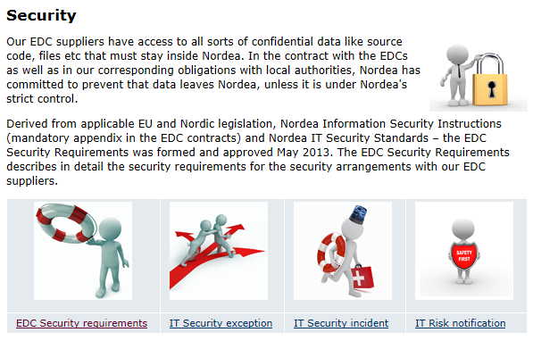
Security – a snapshot from Nordea EDC Intranet

Slide 7




Suppliers
Active in 20+ countries
Over 14.000 employees
2.000 employees in India
Tieto is the largest Nordic IT services company
Active in 40+ countries
Over 50.000 employees
17.000 employees in India
Leading global IT services and solutions service provider from India, ranked top 6 Indian Service providers by NASSCOM
Active in 40+ countries
Over 170.000 employees
55.000 employees in India
Capgemini was named as a 2014 World’s Most Ethical Company by the Ethisphere Institute for the 2nd Year
Active in 56 countries
Over 358.000 employees
90.000 employees in India
95 of Accenture’s top 100 clients have worked with the firm for at least 10 years.

